Slide 1
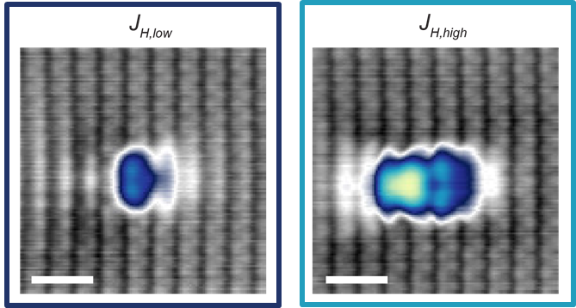
Studying the mechanism behind orbital memory switching in Co/BP
Nikhil Seeja Sivakumar, Sebastian Scherb, Hermann Osterhage, Kira Junghans, Nadine Hauptmann, Alexander Khajetoorians

Slide 2
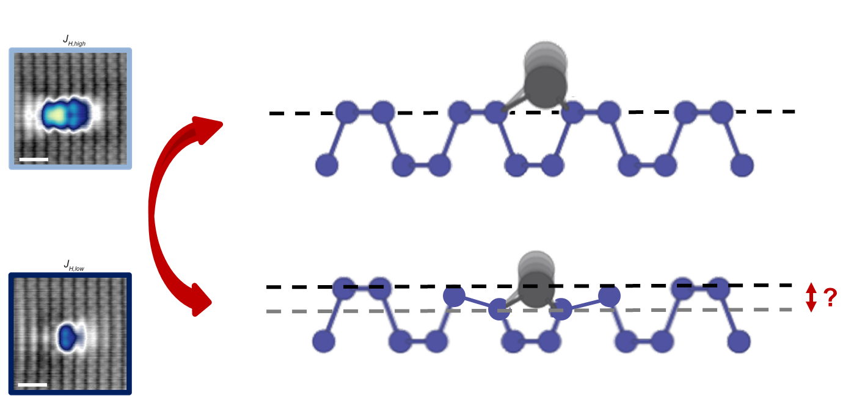
Questions:
Is the mechanism of orbital memory related to local buckling of BP lattice?

Slide 3
Questions:
Is the mechanism of orbital memory related to local buckling of BP lattice?
Can we quantify adsorption height differences of different states?
e⁻
d?
BP

Slide 4
Questions:
Is the mechanism of orbital memory related to local buckling of BP lattice?
Can we quantify adsorption height differences of different states?
Can we quantify the spatial distribution of charge on a semiconductor?
For Co/BP is the spatial anisotropy in switching related to this?
e⁻
d?
weak dielectric
more hopping
charge delocalized
Many body problem
e⁻
e⁻
e⁻
e⁻
e⁻
semiconductor

Slide 5
Questions:
Is the mechanism of orbital memory related to local buckling of BP lattice?
Can we quantify adsorption height differences of different states?
Can we quantify the spatial distribution of charge on a semiconductor?
For Co/BP is the spatial anisotropy in switching related to this?
Is this a polaron?
e⁻
d?
weak dielectric
more hopping
charge delocalized
Many body problem
e⁻
e⁻
e⁻
e⁻
e⁻
semiconductor

Slide 6
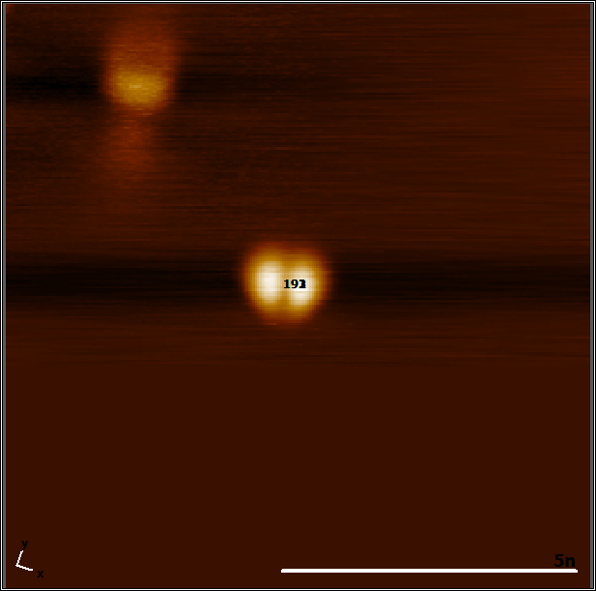
Fish: Voltage dependent df and dI/dV
3d Co state
Charging peak
Dip corresponding to the charging peak.
The 3d Co state does not show a clear signature in df.
16 datasets with 9 different tips.

Slide 7
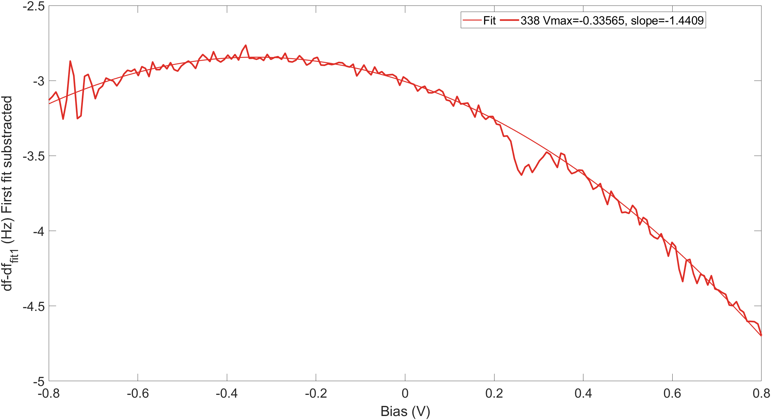
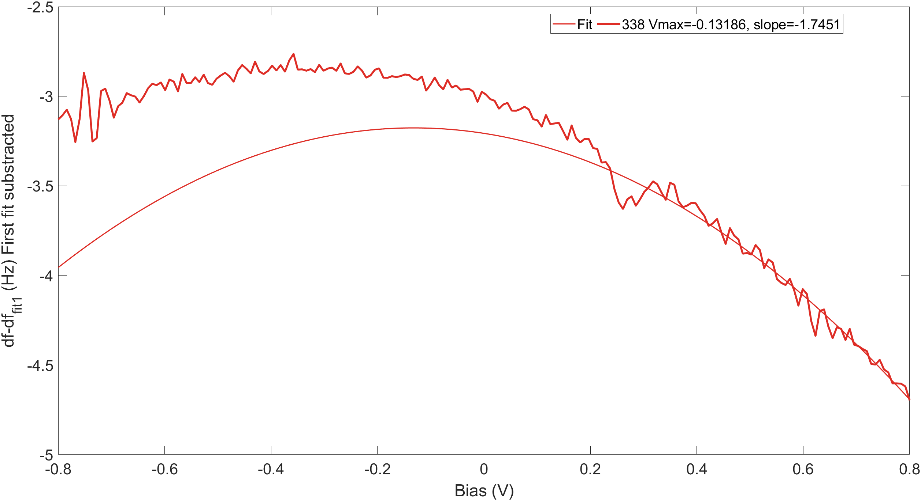
Identifying different parabolas
Fitting full range
Fitting individual region
Cannot fit two different parabolas reliably.
Might not have two different LCPD max.

Slide 8
Voltage dependent df and dI/dV at different heights
Dip and peaks shift correspondingly.
(independent of the oscillation)
Feature around -0.6mV.
I cross-talk ?
features in excitation
SAMPLE
16 datasets with 9 different tips.

Slide 9
Spatial dependence
B
-400mV,10pA
Dip shifts to larger energies away from the atoms
Dip becomes shallow and broader in energy away from the atom
4 datatsets with 3 different tips.

Slide 10
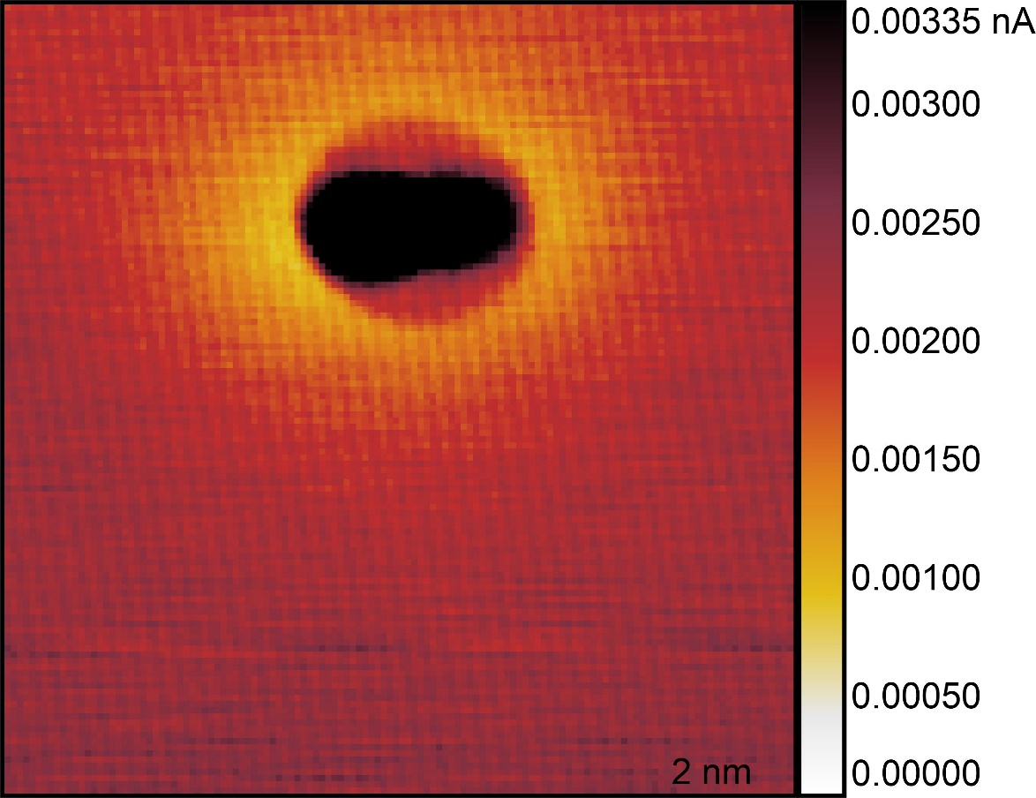
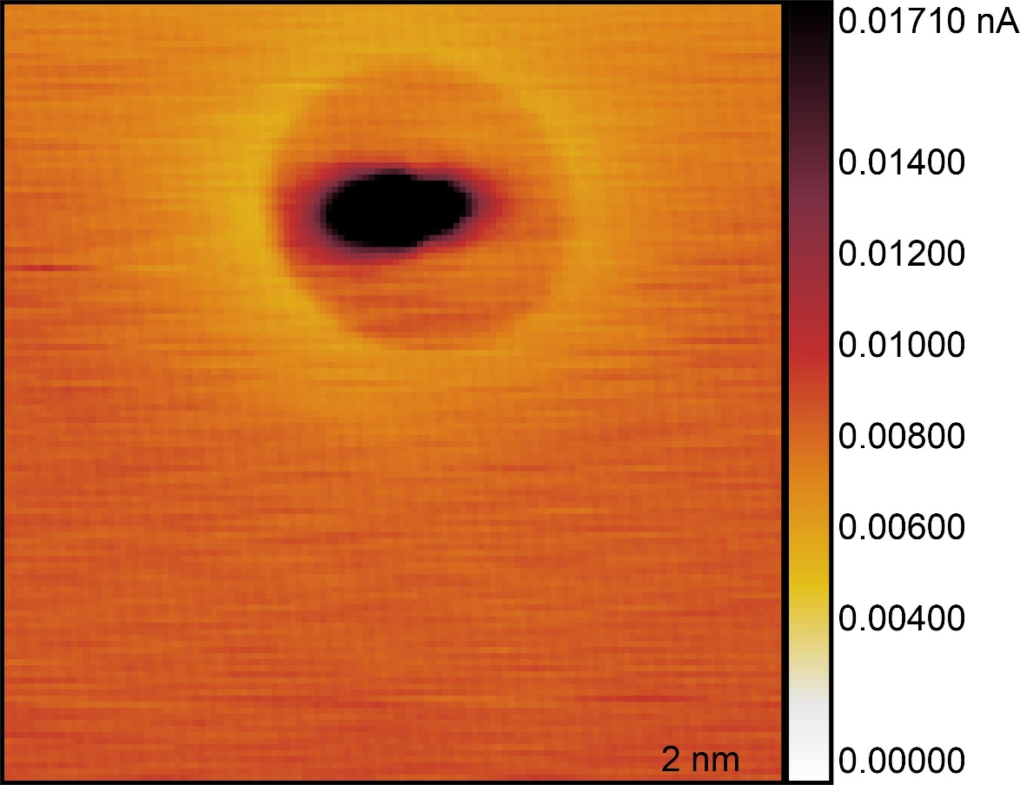
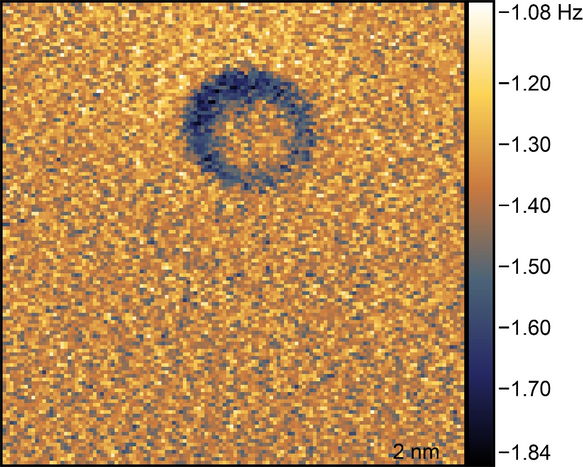
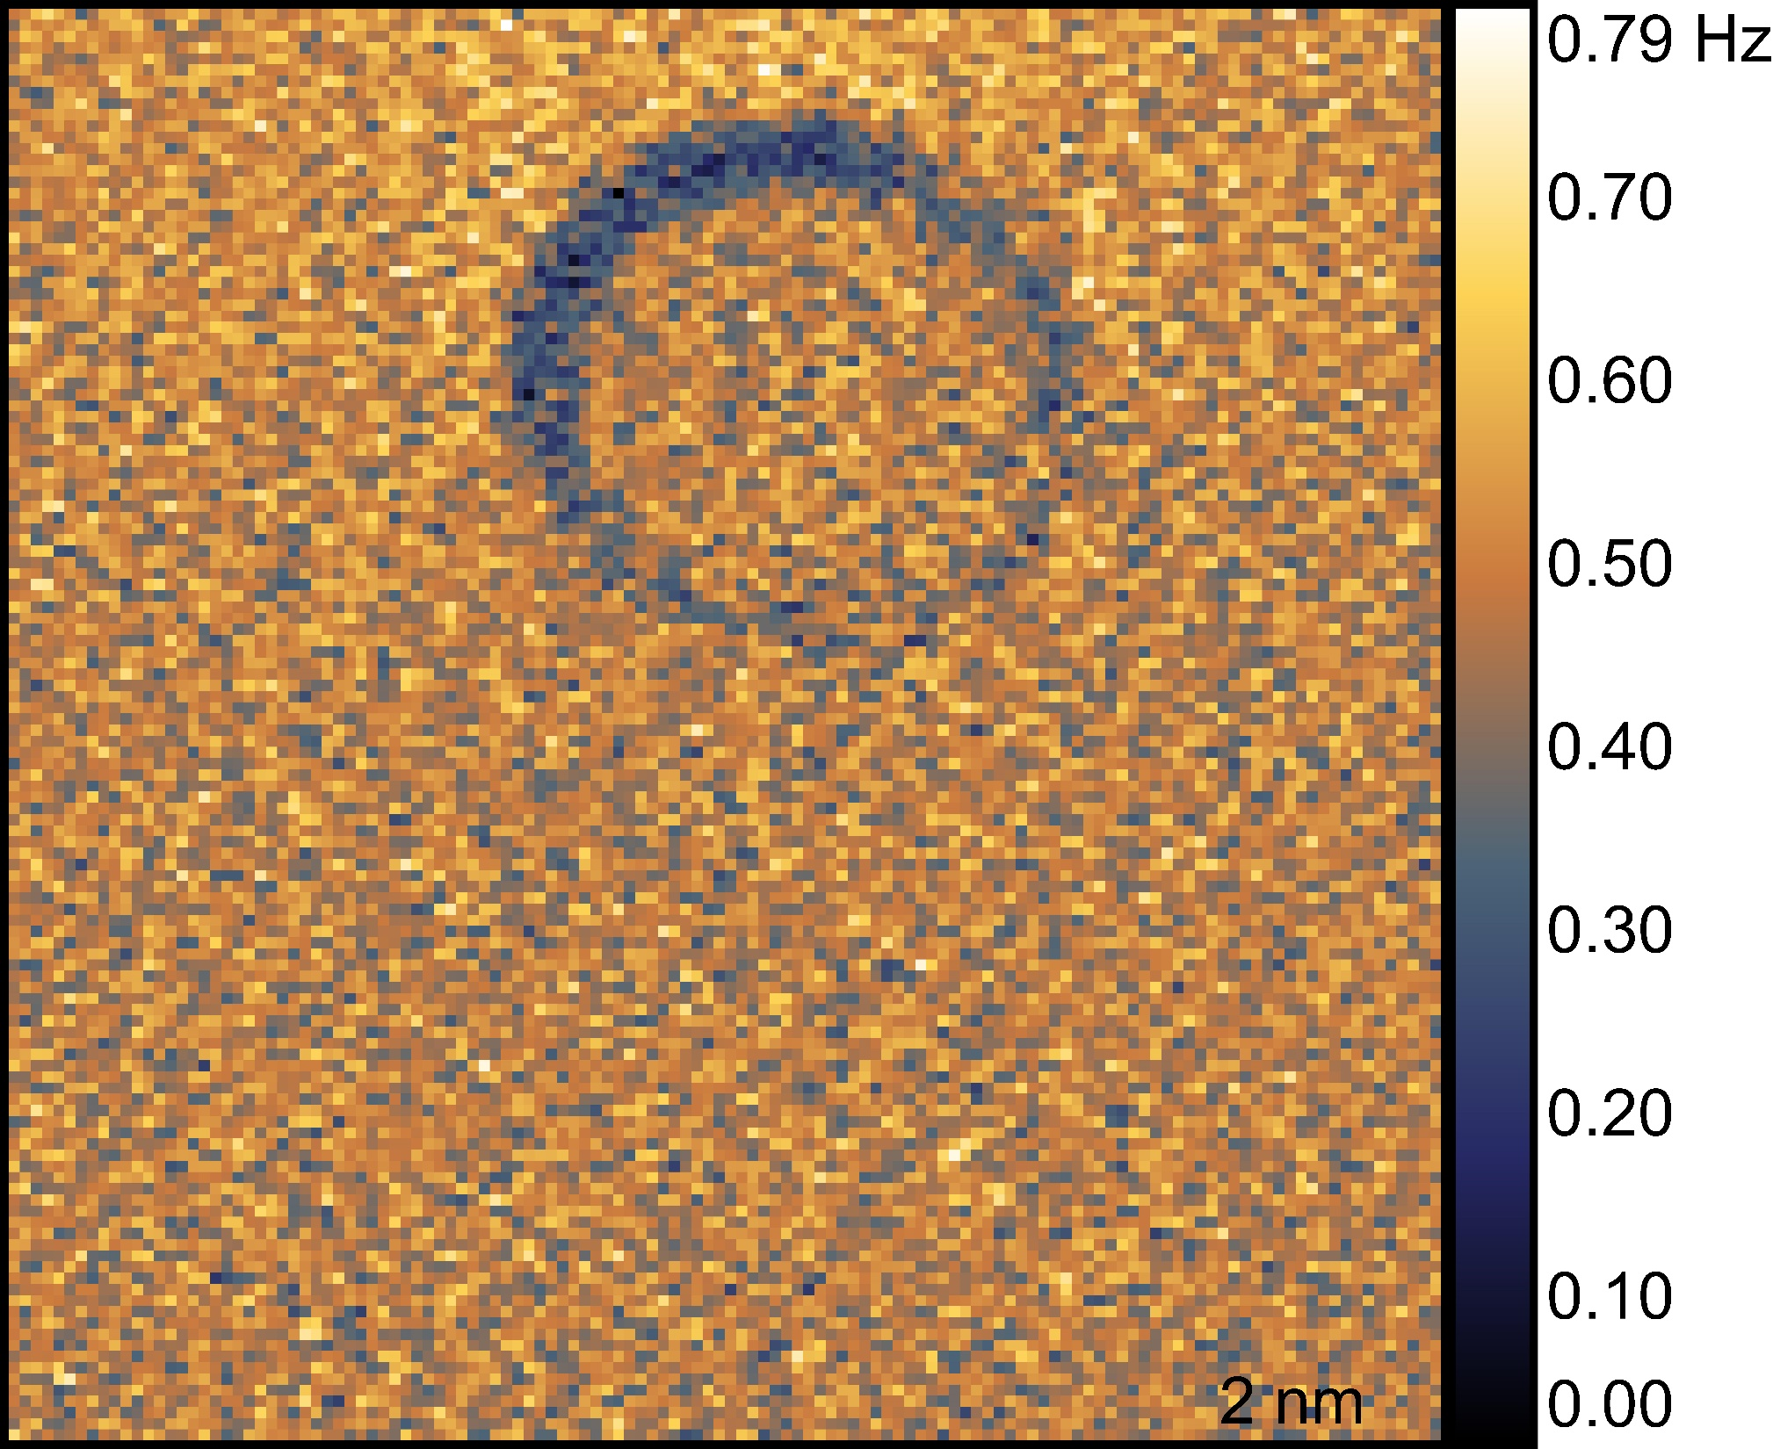
Spatial extent of charging: charging ring
+550mV
+650mV
Current: disc
df: ring
In frequency shift:
Shape of the ring: isotropic
Contrast within ring: anisotropic
Tip shape?
sample tilt?
Current
Frequency shift
3 datatsets with 3 different tips.
But not all are circular features (tip shape?).

Slide 11

Spatial extent of charging: charging ring
+550mV
+650mV
Current: disc
df: ring
In frequency shift:
Shape of the ring: isotropic
Contrast within ring: anisotropic
Tip shape?
sample tilt?
Current
Frequency shift
3 datatsets with 3 different tips.
But not all are circular features (tip shape?).

Slide 12
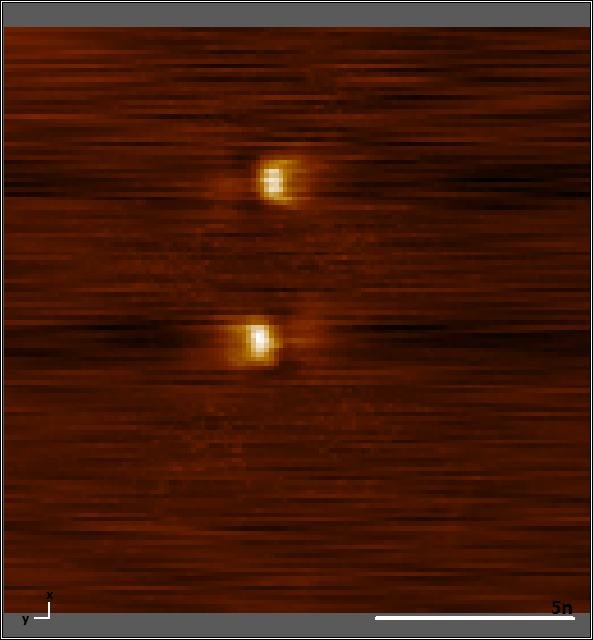
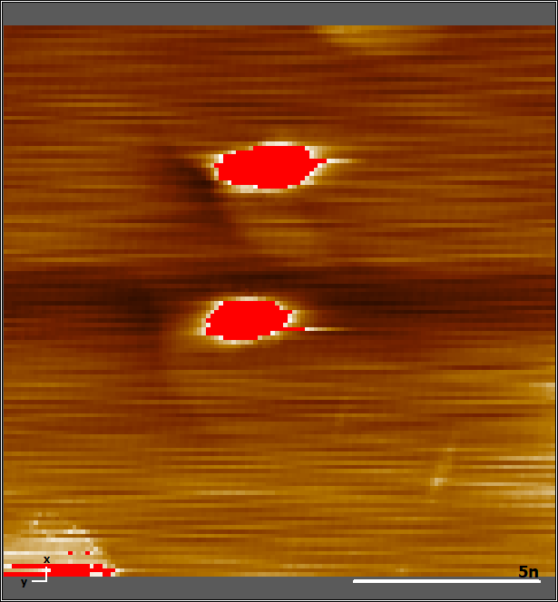
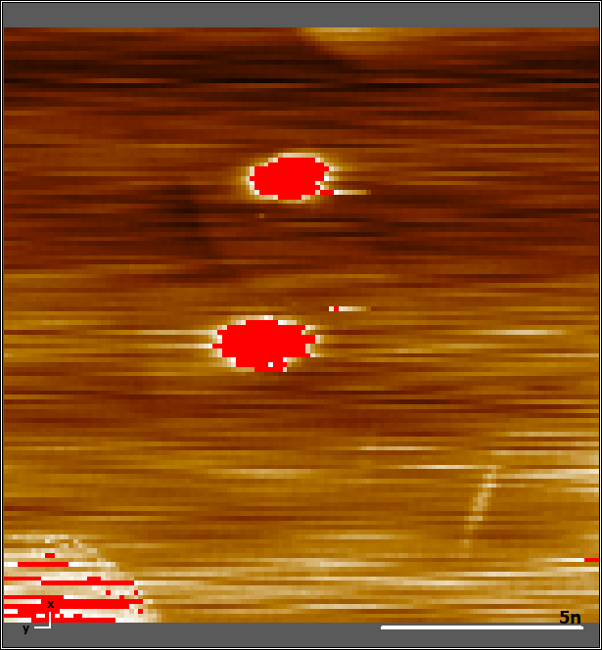
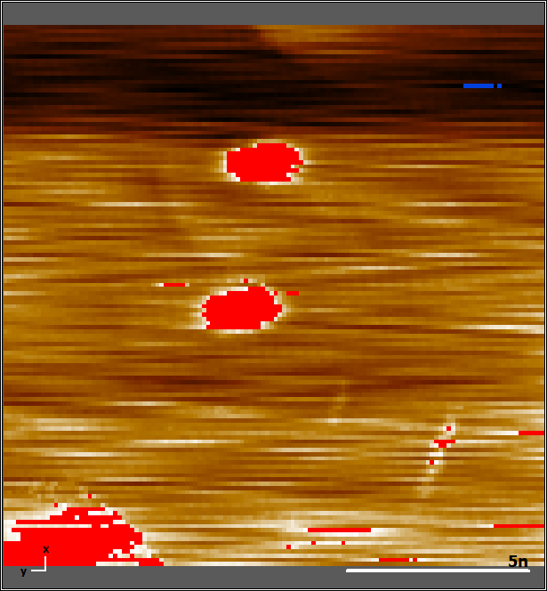
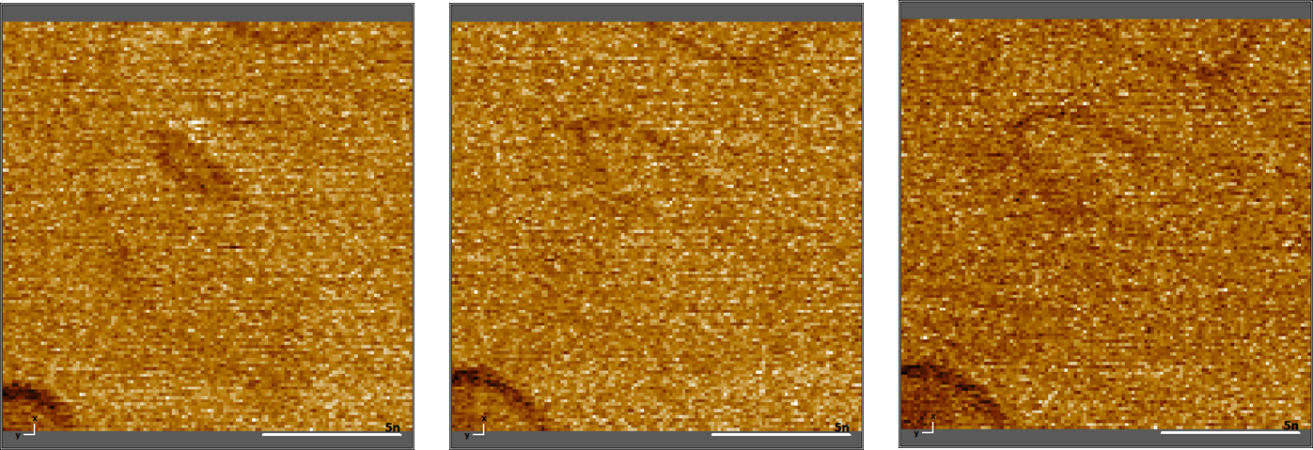
Coupled atoms: charging ring
550mV
650mV
750mV
One charging ring for each fish.
With increasing voltage, charging ring expands. (Looks like it crosses each other)
The crossed ring part has darker contrast.
On top right & top left there is a butterfly
Current
Frequency shift
Images and spectra stabilised on top of atom @ -800mV,60pA; -40pm closer

Slide 13
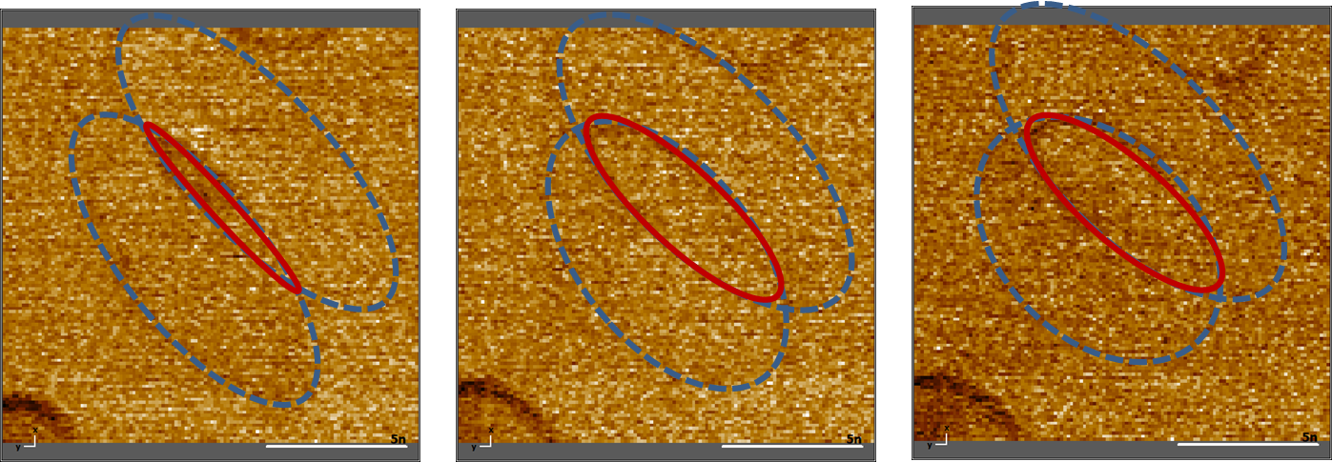
Coupled atoms: charging ring
550mV
650mV
750mV
One charging ring for each fish.
With increasing voltage, charging ring expands. (Looks like it crosses each other)
The crossed ring part has darker contrast.
On top right & top left there is a butterfly
Current
Frequency shift
Images and spectra stabilised on top of atom @ -800mV,60pA; -40pm closer

Slide 14
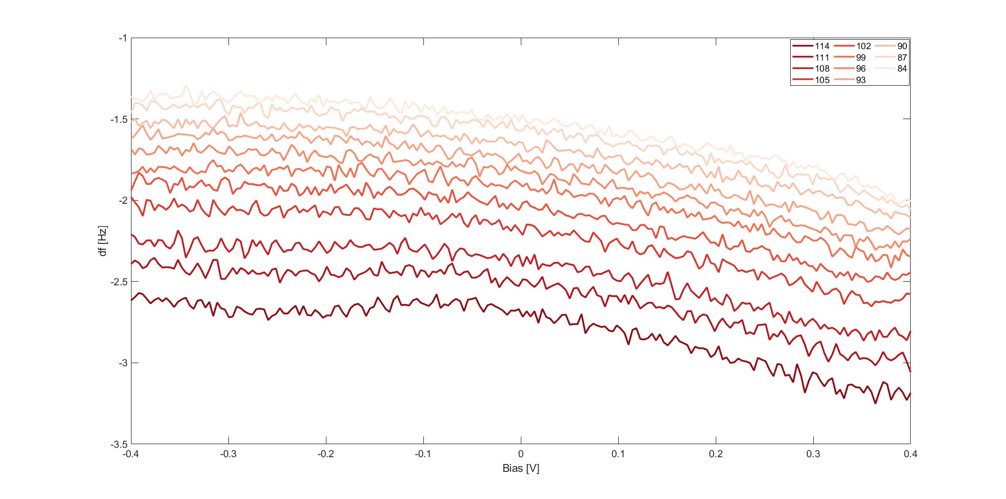
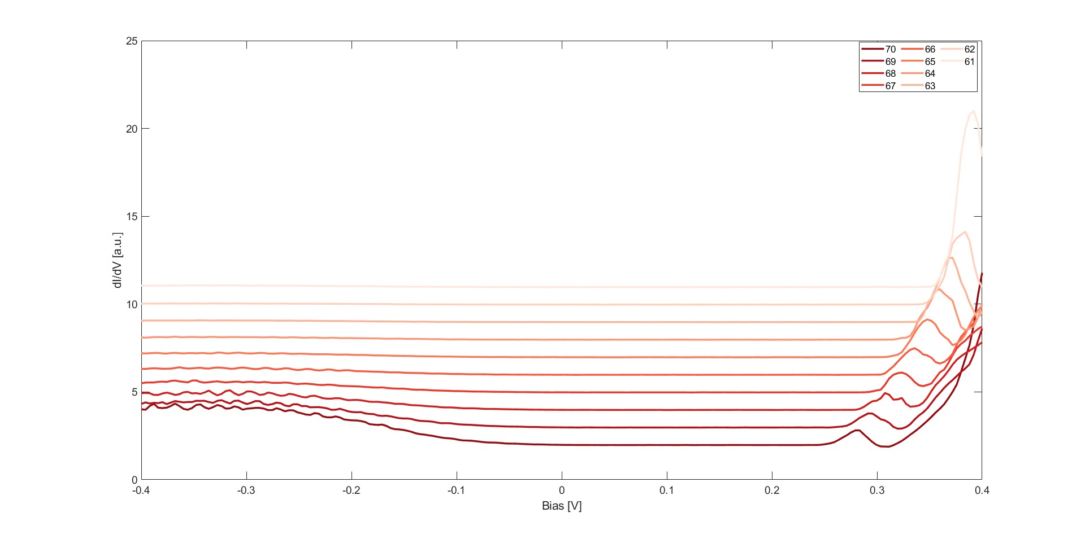
Butterfly: Voltage dependent df and dI/dV
1.
Zoffset = 0 to -200 pm
Zoffset = 0 to -200 pm
7 datatsets with 5 different tips.
-400mV,10pA

Slide 15
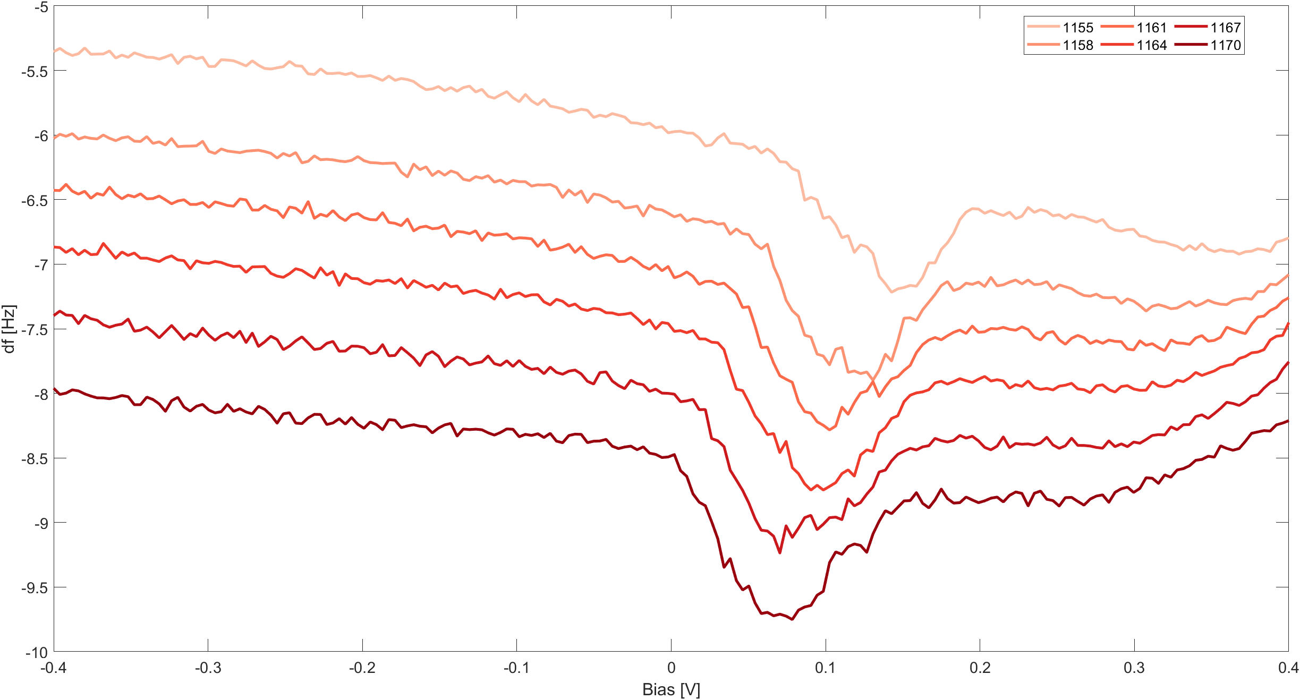
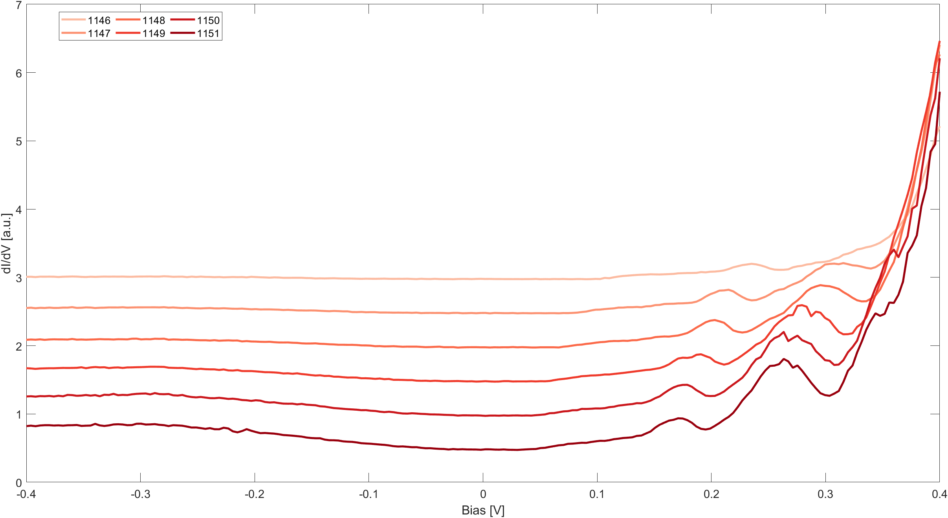
Butterfly: Voltage dependent df and dI/dV
2.
Zoffset = 0 to -120 pm
Zoffset = 0 to -120 pm
5 datasets with 3 different tips.

Slide 16
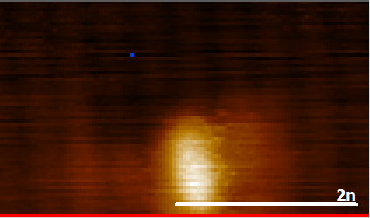
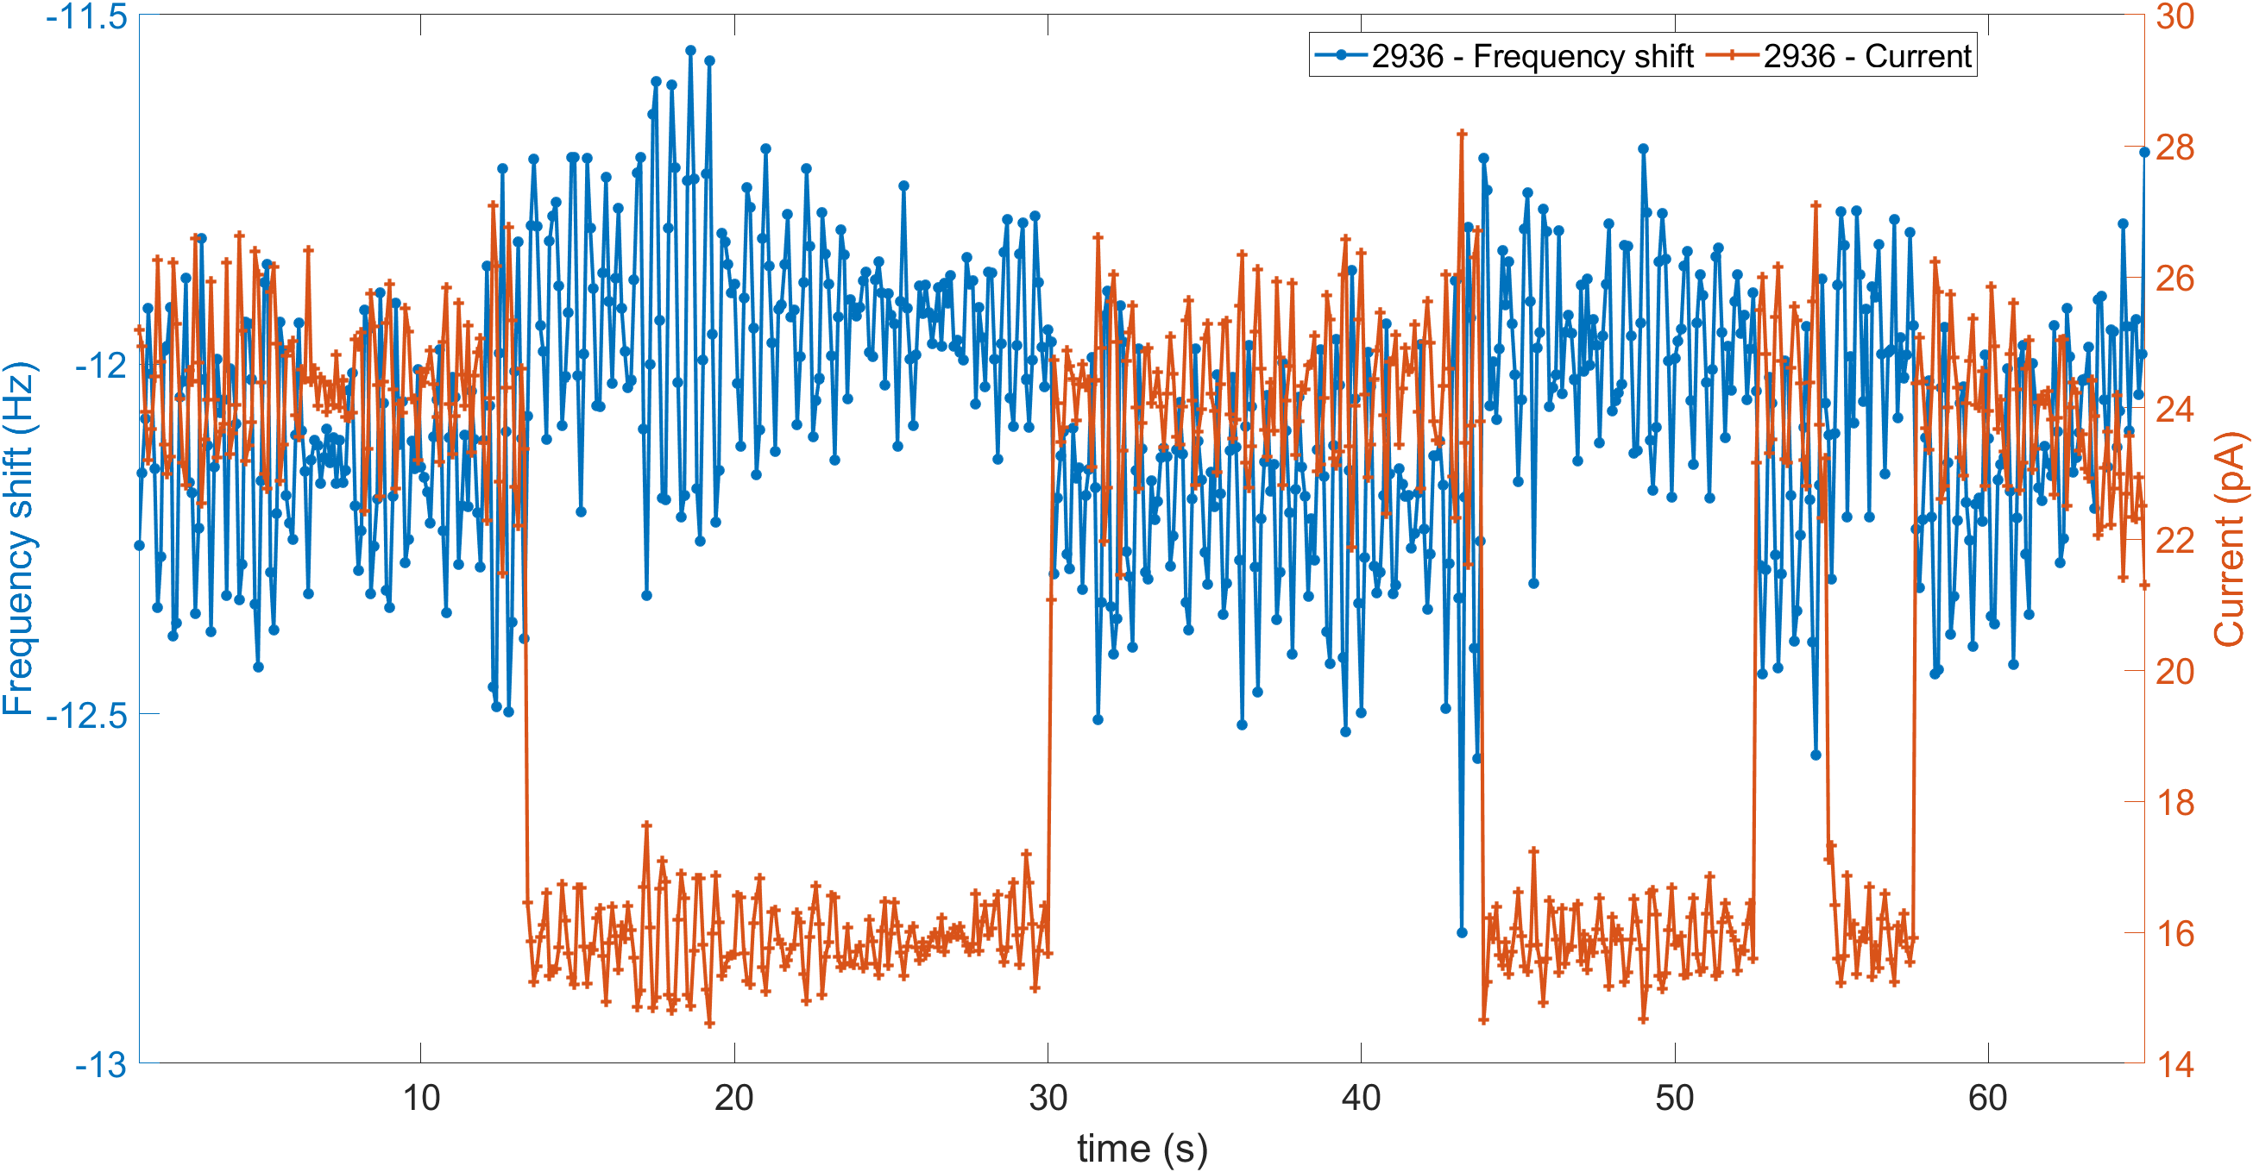
Fish: Switching
450 mV
1.1 nm
-11.93 ± 0.15 Hz
-12.13 ± 0.15 Hz
Δdf = 0.20 Hz
Distance from atom (nm) | Δdf
1 nm | 0.22 ± 0.3
1.1 nm | 0.20 ± 0.3
1.2 nm | 0.22 ± 0.3
2 datasets with 1 tip

Slide 17
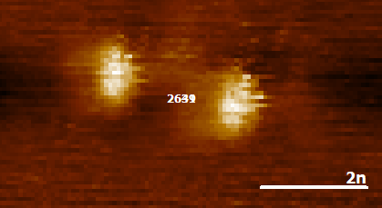
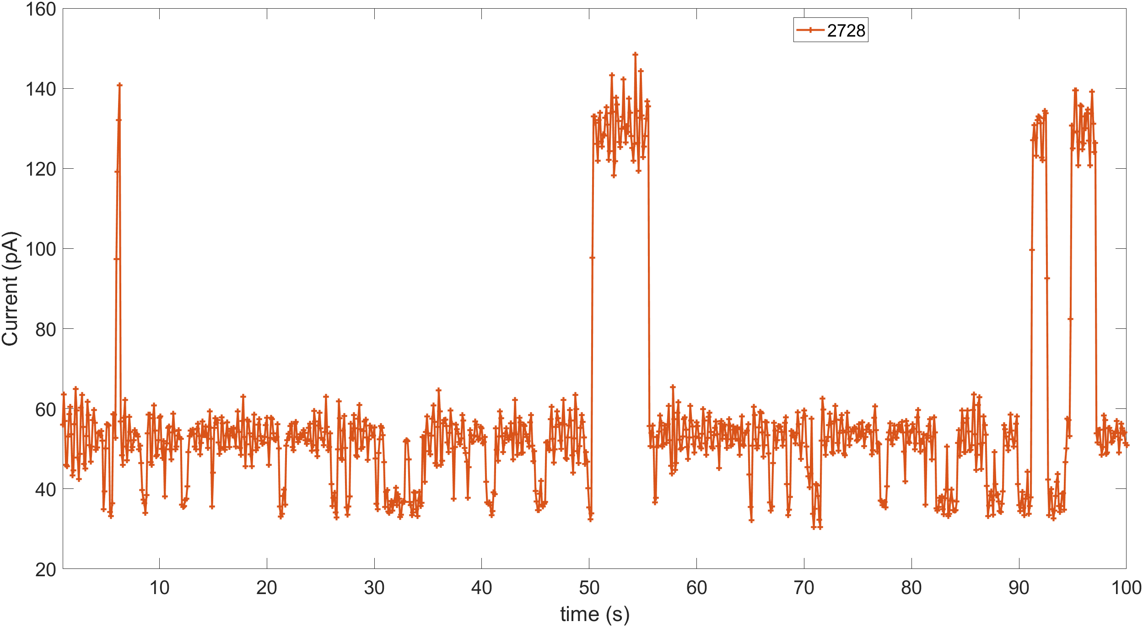
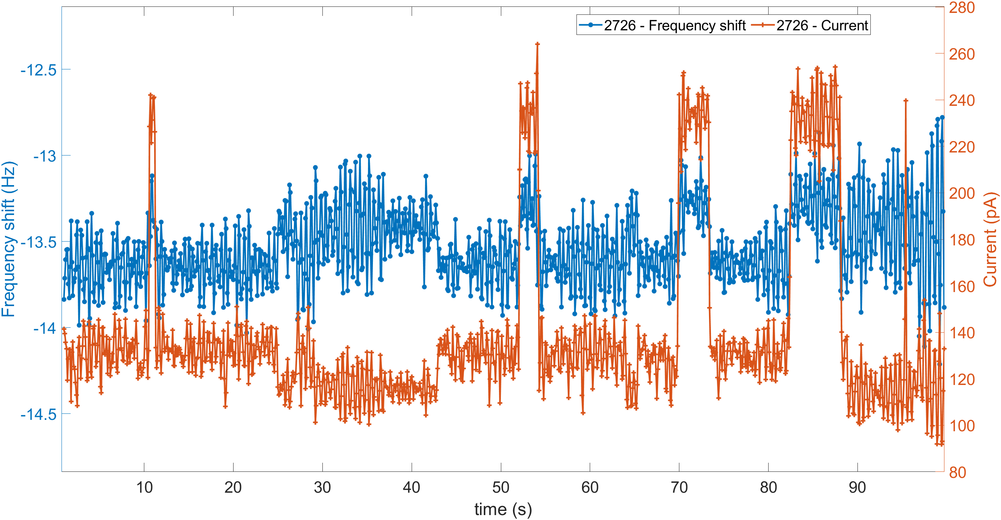
Coupled atoms: switching
Oscillation OFF
Current: 3 states clearly observed
Oscillation ON
Current: 2 states observed
AC field of the tip alters (?).
Df: 2 states observed (Δdf ~ 0.3Hz)
2 datasets with 1 tip

Slide 18
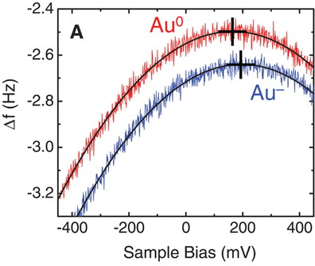
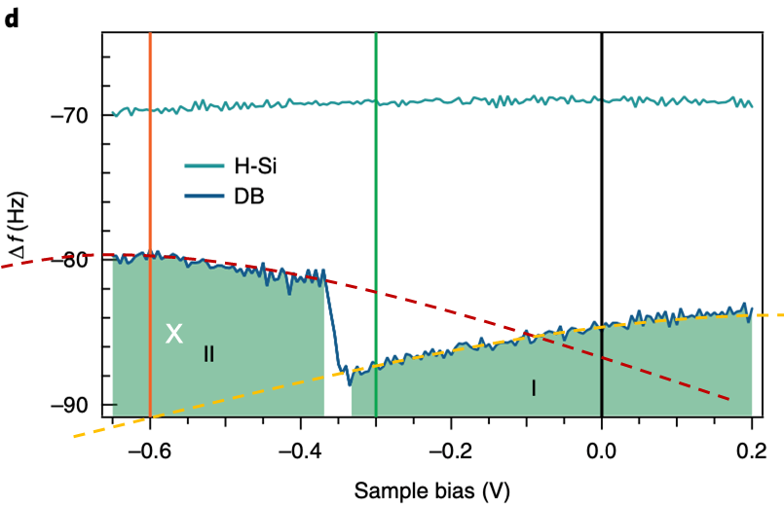
LCPD on different charges
Possible explanation for dip in LCPD
Shift in the maxima of parabola
⟹ change in work function
⟹ difference in charge
charging neutral ⟹ negative
jump to new parabola
Leo Gross, et al., Science 324 (2009)

Slide 19
Possible explanation for dip in LCPD
Why a dip and not a shift?

Slide 20
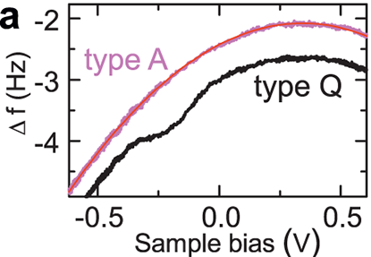
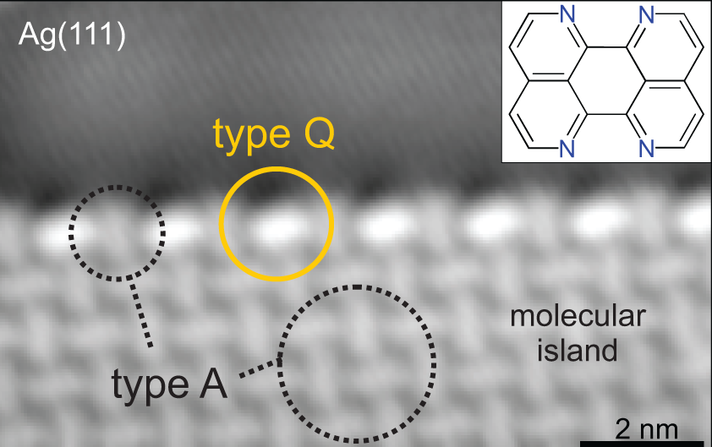
Possible explanation for dip in LCPD
Islands of TAPE on Ag111
Why a dip and not a shift?
Dip feature: charging event at type Q
Seen in other molecules on conducting substrates
N. Kocic et. al. Nano Lett. 15, 4406−4411 (2015)
Carbon 216 (2024); Advanced Material interfaces 7, 15 (2020); J. Appl. Phy. 55,08NAO (2016);

Slide 21
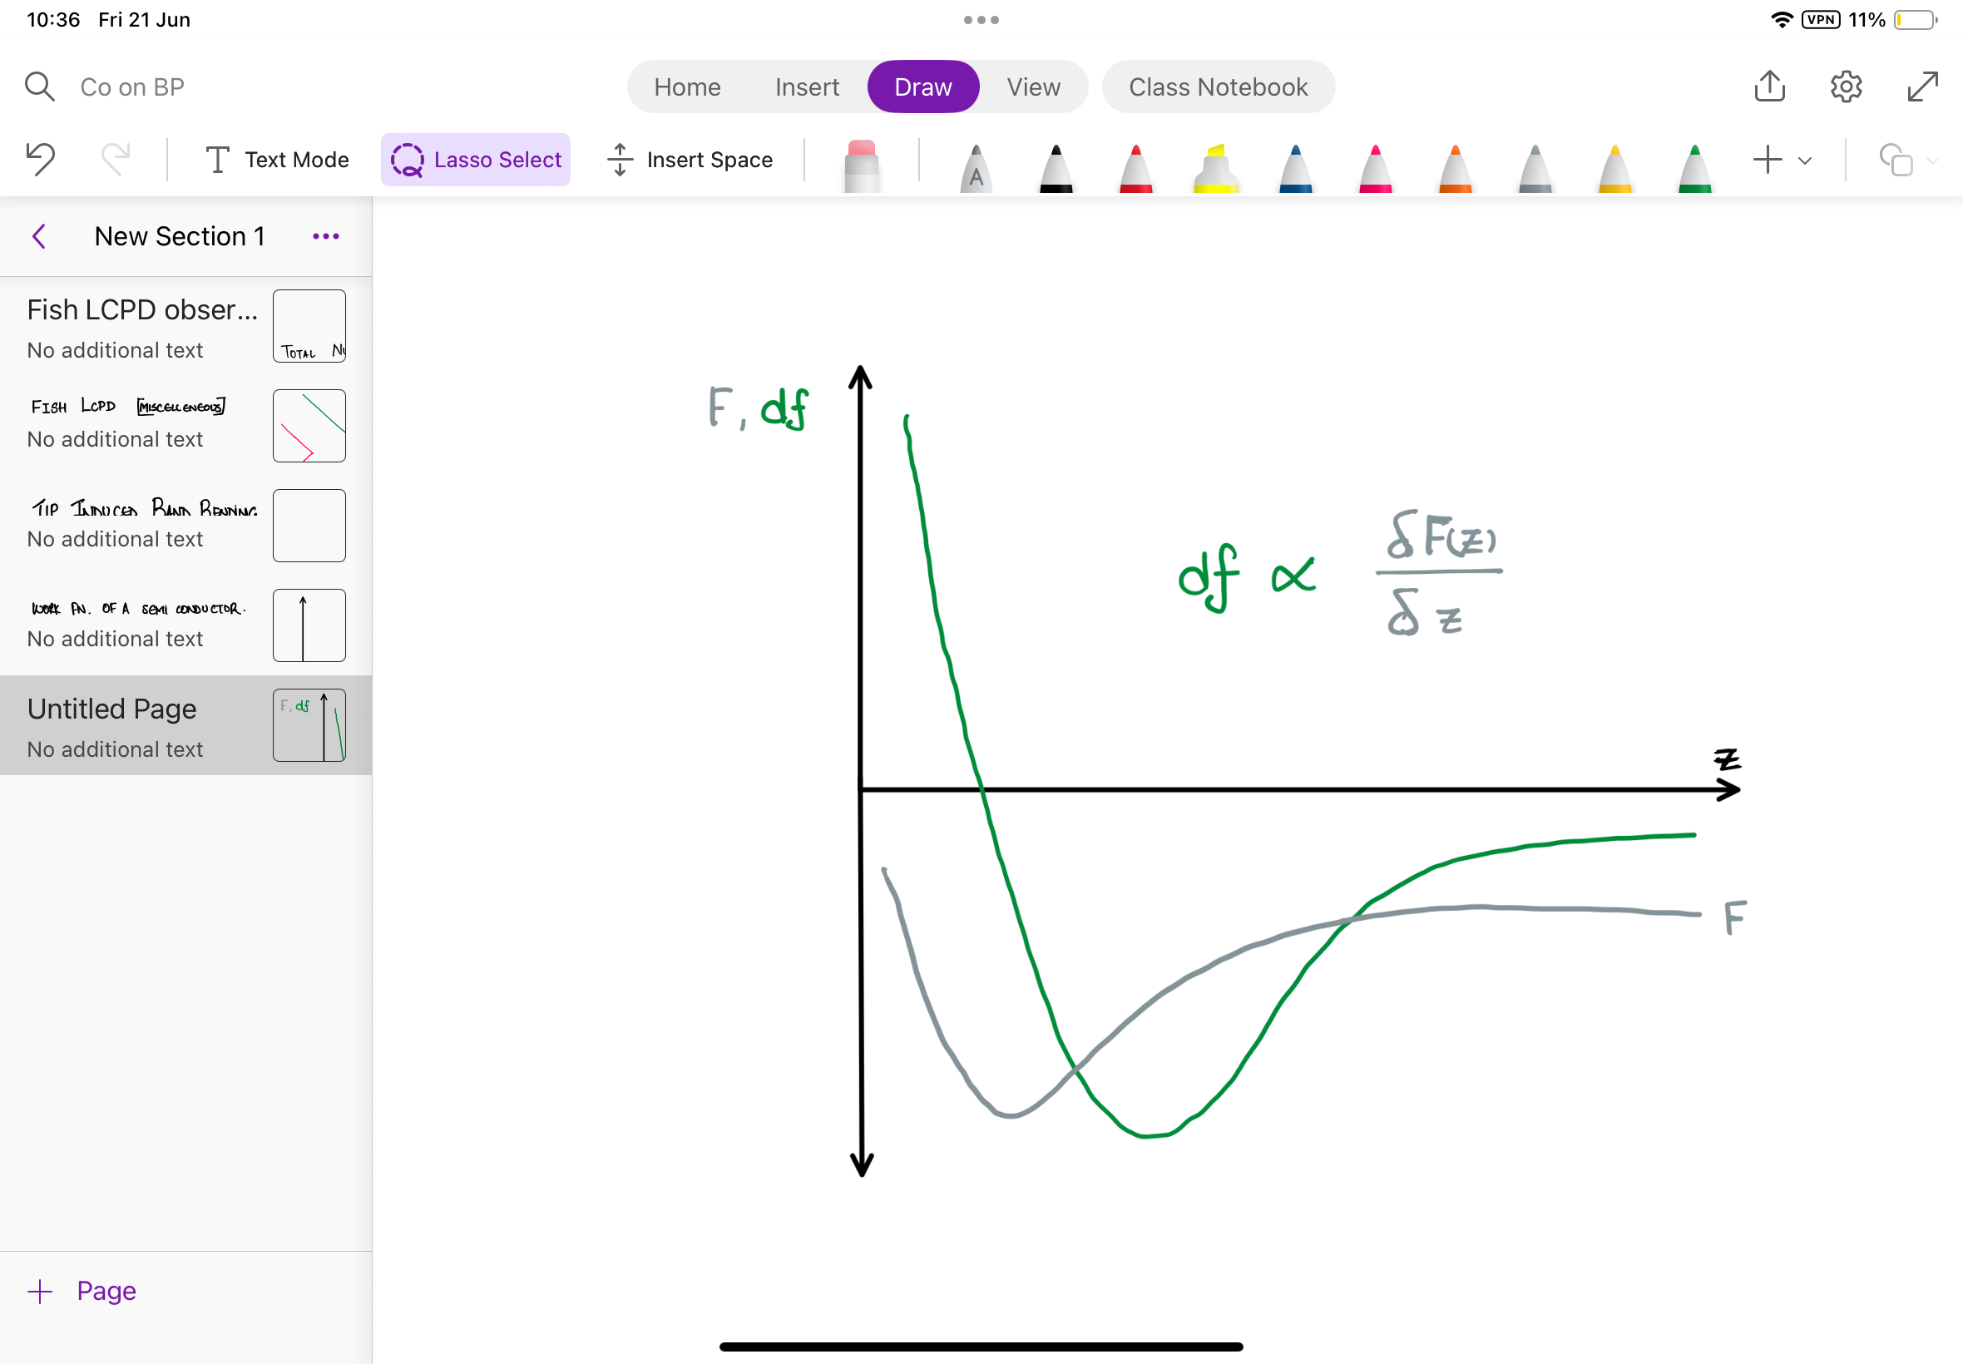
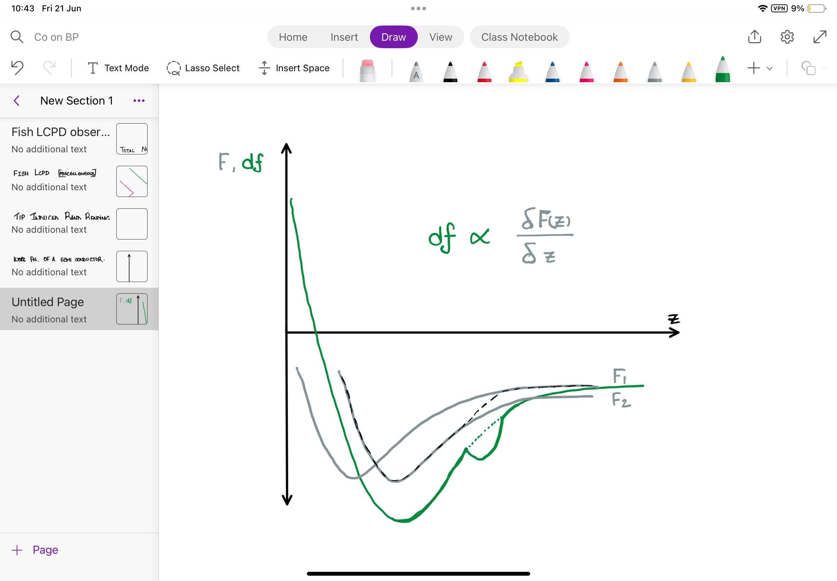
Possible explanation for dip in LCPD
If a rigid shift of force curves: F1 & F2
df remains same, since slope
Except in the area where there is a change.
N. Kocic et. al. Nano Lett. 15, 4406−4411 (2015)

Slide 22
Possible explanation for dip in LCPD
If a rigid shift of force curves: F1 & F2
df remains same, since slope
Except in the area where there is a change.
Could the dip quantify the charging energy?
N. Kocic et. al. Nano Lett. 15, 4406−4411 (2015)

Slide 23
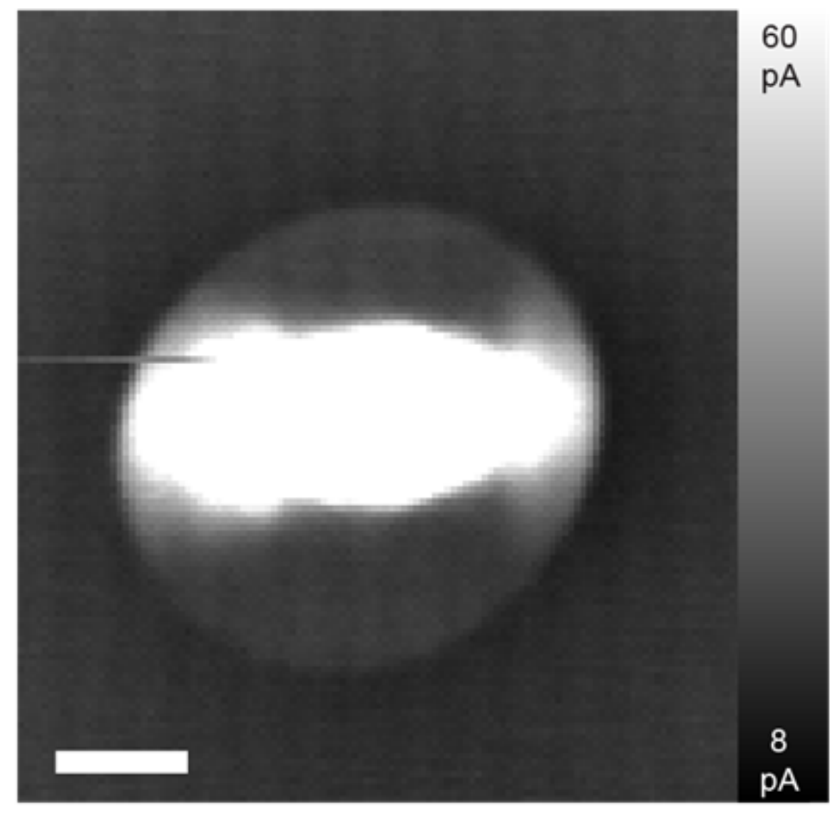
Ideas for further measurement
Can we quantify the dip observed in the df(V) as a charging energy scale: use of df(z) instead?
Is there a shift in LCPD max spatially (with low noise)?
How does this relate to the screening length and its anisotropy?
Is this even a parabola?
010
100

Slide 24
Ideas for further measurement
Can we quantify the dip observed in the df(V) as a charging energy scale: use of df(z) instead?
Is there a shift in LCPD max spatially (with low noise)?
How does this relate to the screening length and its anisotropy?
Is this even a parabola?
Anisotropic contrast of charging ring in df:
Is this reproducible?
Is this related to the spatial difference in screening?
Df image at +650mV

Slide 25
Ideas for further measurement
Can we quantify the dip observed in the df(V) as a charging energy scale: use of df(z) instead?
Is there a shift in LCPD max spatially (with low noise)?
How does this relate to the screening length and its anisotropy?
Is this even a parabola?
Anisotropic contrast of charging ring in df:
Is this reproducible?
Is this related to the spatial difference in screening?
Can we measure an apparent height difference between different states?
(compensated for electrostatic forces)
Fish: LCPD first part of the parabola fitted → C.H. df image (Δdf₁)
Mushroom: LCPD first part of the parabola fitted → C.H. df image (Δdf₂)
Coupled atoms (might only work for similar speies)

Slide 26
Ideas for further measurement
Can we quantify the dip observed in the df(V) as a charging energy scale: use of df(z) instead?
Is there a shift in LCPD max spatially (with low noise)?
How does this relate to the screening length and its anisotropy?
Is this even a parabola?
Anisotropic contrast of charging ring in df:
Is this reproducible?
Is this related to the spatial difference in screening?
Can we measure an apparent height difference between different states?
(compensated for electrostatic forces)
Fish: LCPD first part of the parabola fitted → C.H. df image (Δdf₁)
Mushroom: LCPD first part of the parabola fitted → C.H. df image (Δdf₂)
Coupled atoms (might only work for similar speies)
Is the switching observed differently in df?
Does the change in df while switching compare with (Δdf₁- Δdf₂)

Slide 27
……..

Slide 28
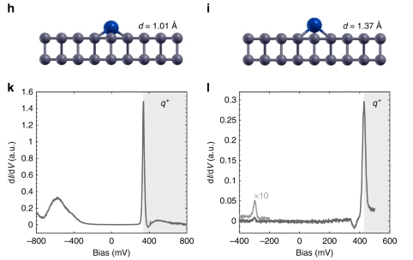
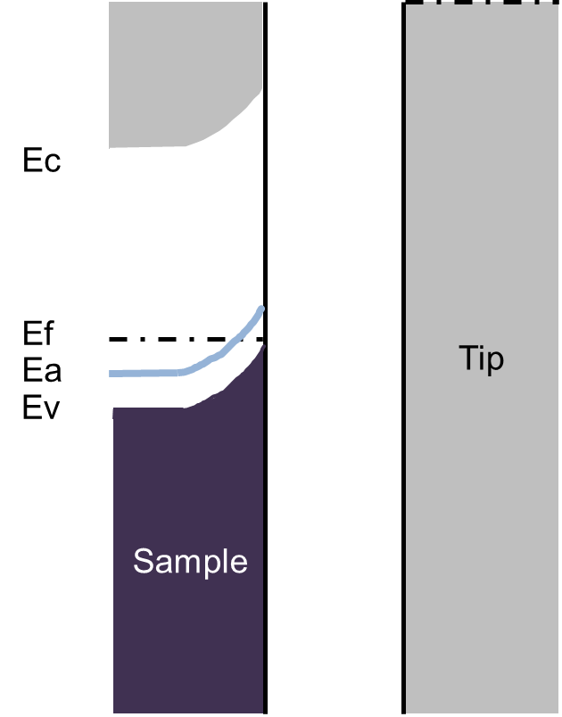
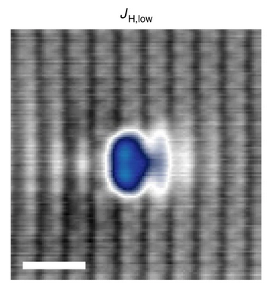
Charging event in STS
Charging peak
3d Co state
B. Kiraly, et al., Nat. Comm. 9, 3904 (2018)

Slide 29
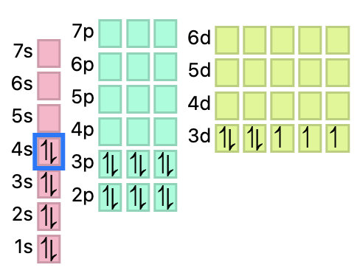
Orbital memory
Co
SUBSTRATE
T. O. Wehling et.al. PRB 84, 235110 (2011)
Fig: ptable.com

Slide 30
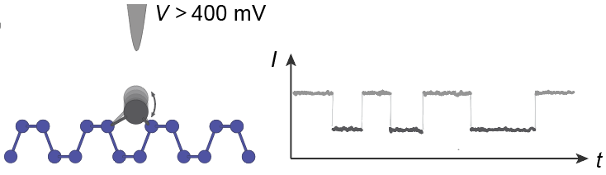
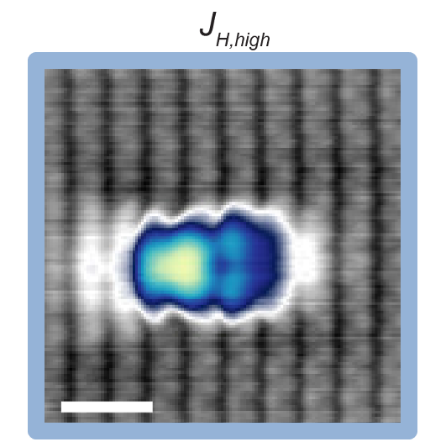
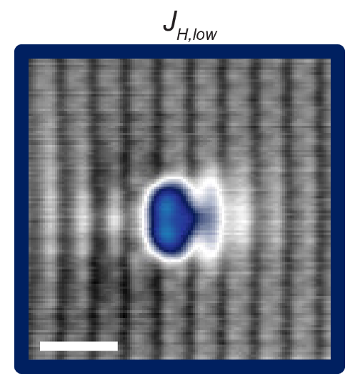
Question 1: Local buckling of BP lattice ?
Charging peak
3d Co state
?
Does the BP lattice buckle locally? If so, can we observe/quantify this?
Image: B. Kiraly

Slide 31
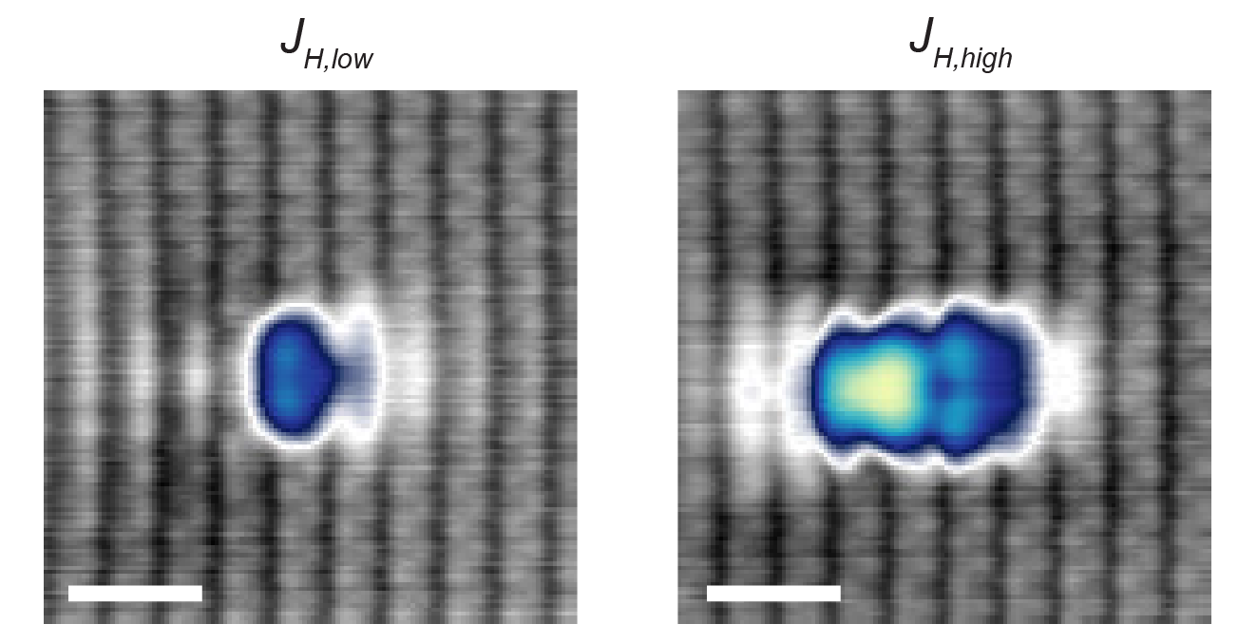
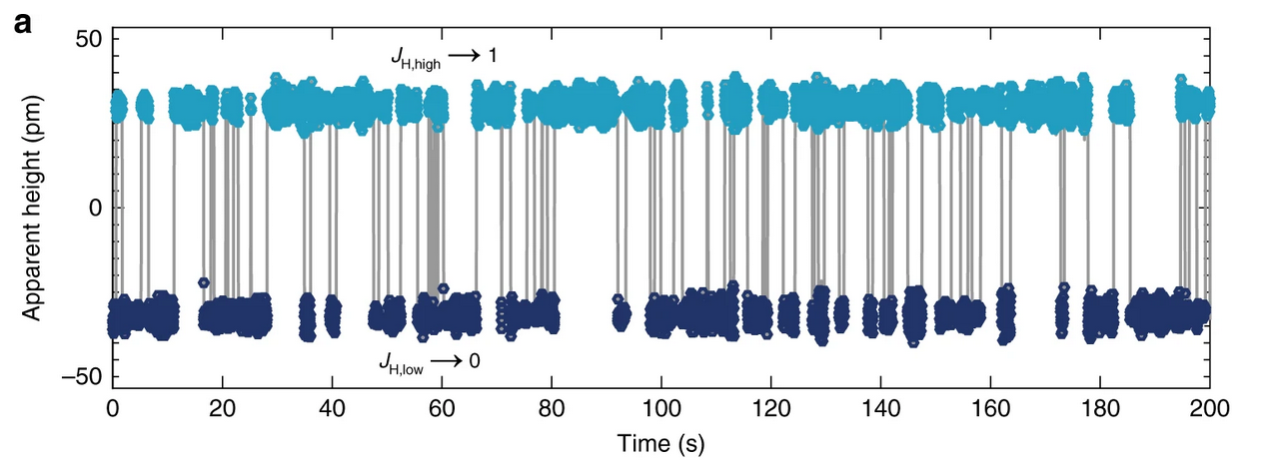
Orbital memory: Co/BP
Hollow sites
bi-stable valency
2 different adsorption height
2 different orbital configuration
Local buckling of BP? How to quantify it?
Reversible switching above threshold.
Configuration stays when electric field is removed.
B. Kiraly, et al., Nat. Comm. 9, 3904 (2018)

Slide 32
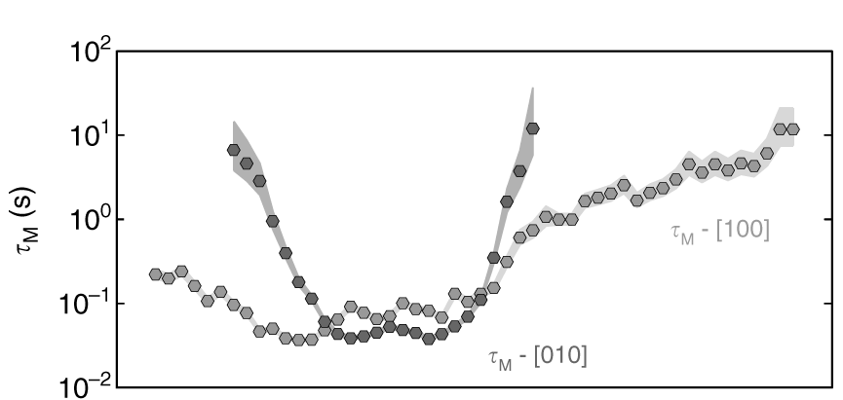
Spatial anisotropic switching
Spatial extent of charging
010
100
010
100
Isotropic charging ring.
Anisotropic switching.
Anisotropic charge cloud?
Co: not a point charge?
Possible multipole?
Inside: charged
Outside: neutral

Slide 33
Question 2: What is the spatial distribution of charge on a substrate?
e-
e-
e⁻
e⁻
e⁻
e⁻
e⁻
INSULATOR
SEMICONDUCTOR
high dielectric
weak hopping
charge localized
Point charge approximation
weak dielectric
more hopping
charge delocalized
Many body problem
How to measure the charge distribution on the semiconductor?

Slide 34
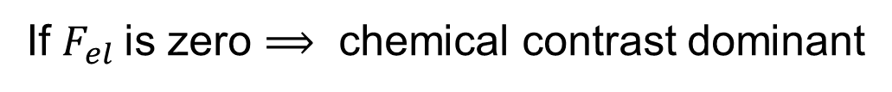
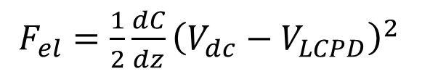
Question 3: Adsorption height difference ?
3d Co state
d ?
e-
Can we quantify the geometric height using AFM?
e⁻
e⁻
e⁻
e⁻
e⁻
SEMICONDUCTOR
$F_{el}=\frac{1}{2}\frac{dC}{dz}{\left(V_{dc}−V_{LCPD}\right)}^{2}$
e⁻
If $F_{el}$is zero ⟹ chemical contrast dominant
e⁻
e⁻
e⁻
e⁻
e⁻
Possible Polaron?
semiconductor

Slide 35
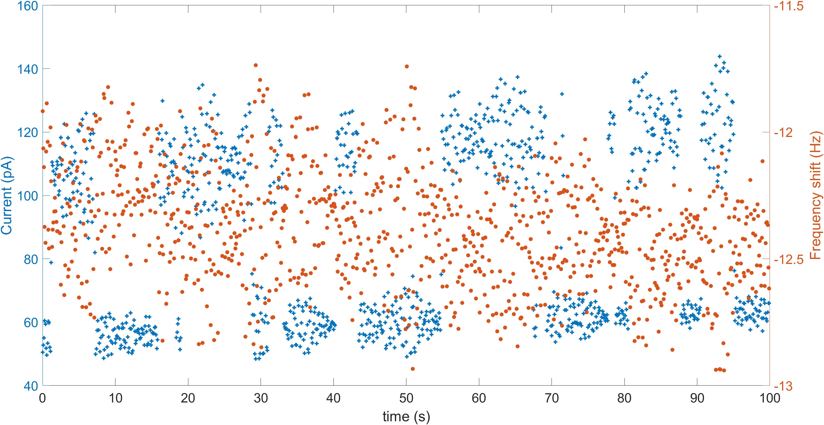
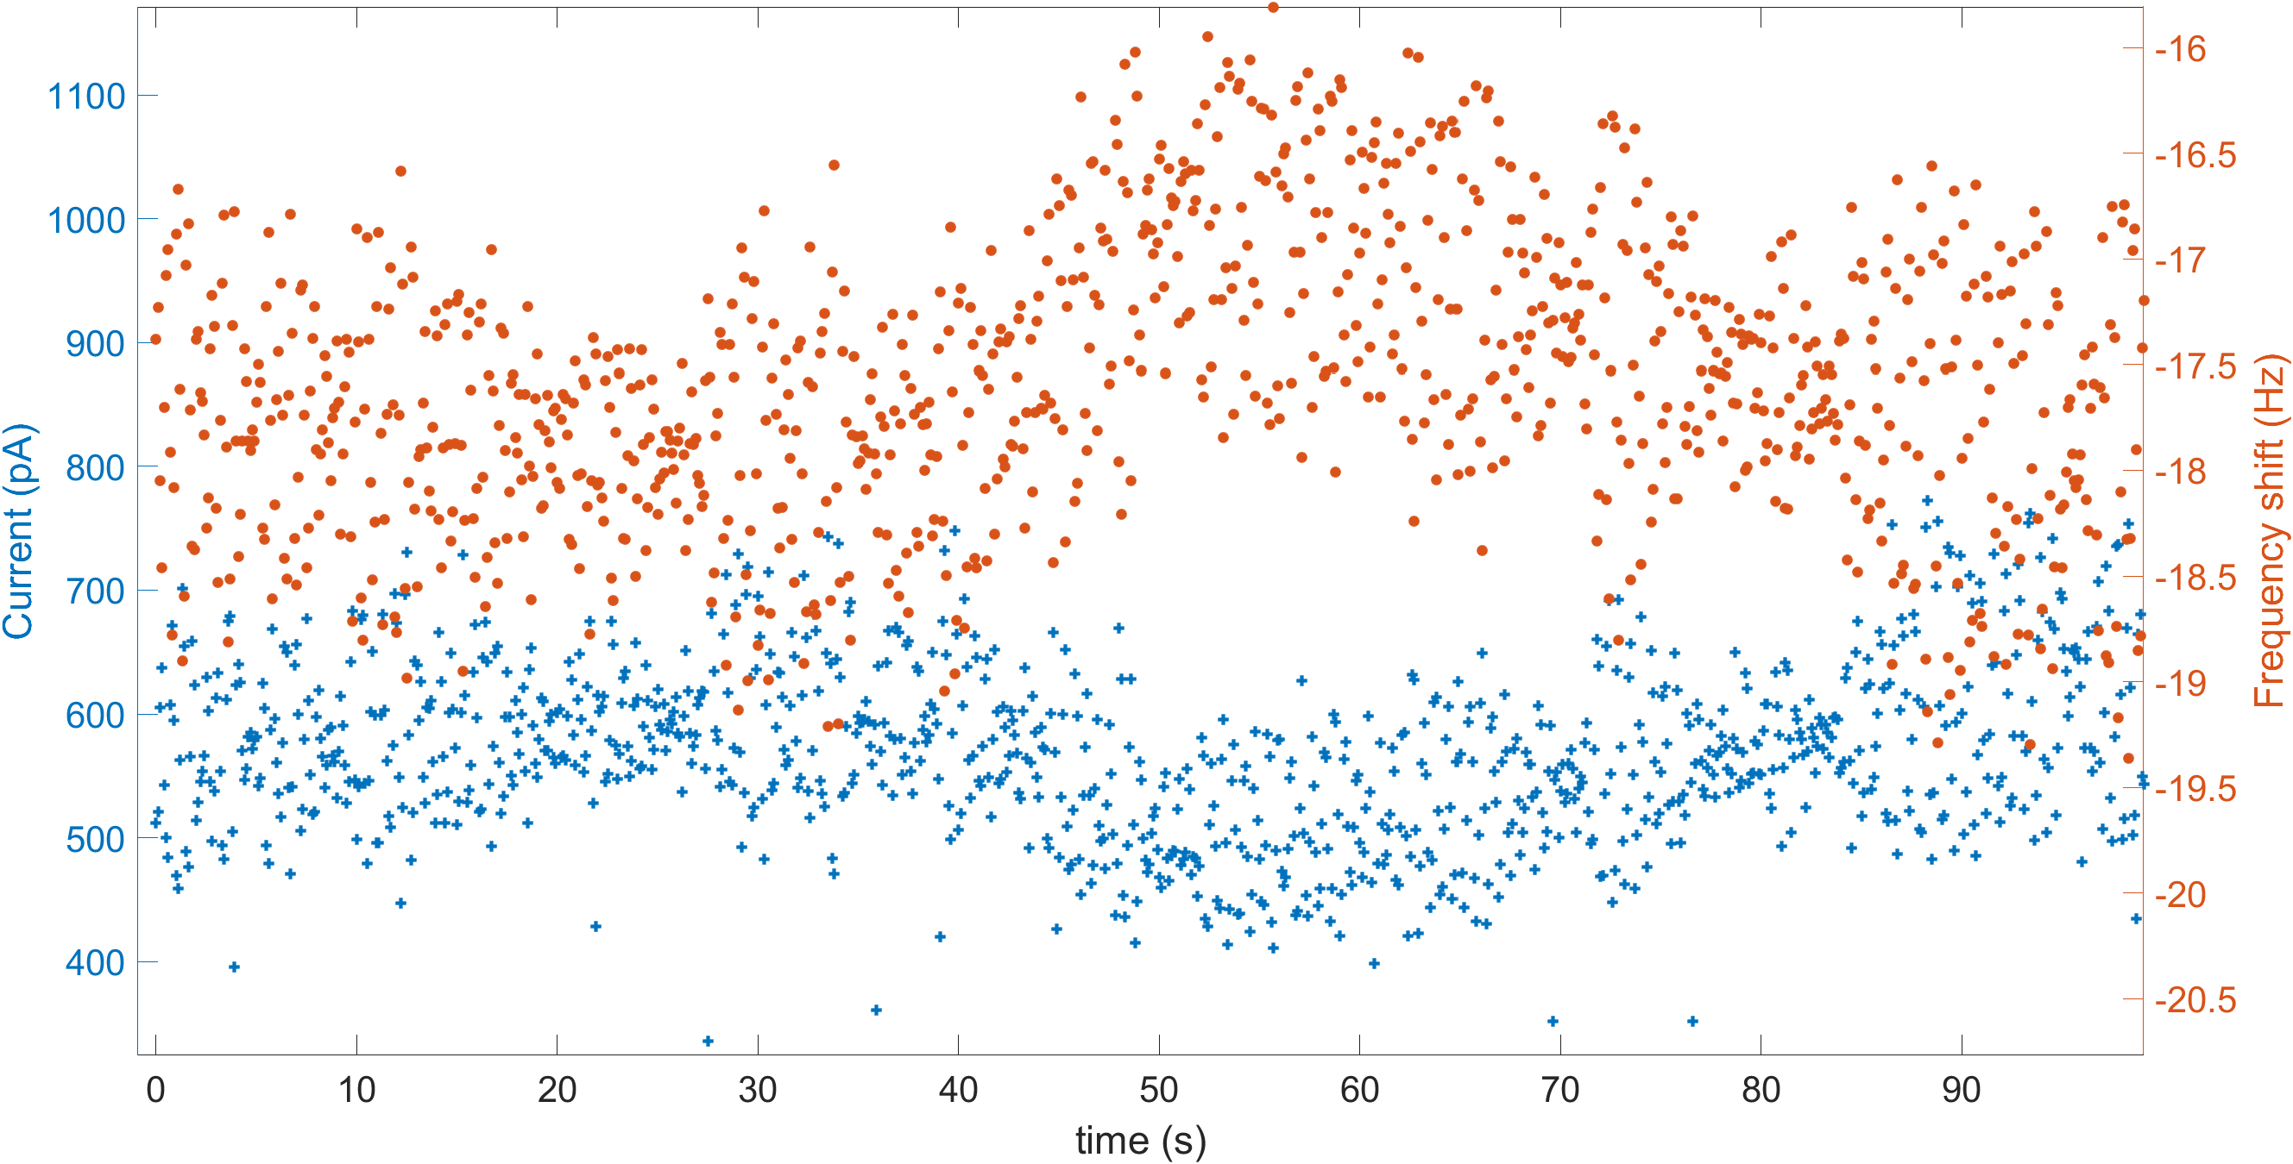
Fish: switching
1.
2.
Current shows two state switching.
Df within the error margin does nto clearly show.
Amplitude dependent AC field becomes important to consider this.
Might need fine tuning.
Switching at LCPD max voltage is the proof of change in adsorption height but no switching at flat band conditions.

Slide 36
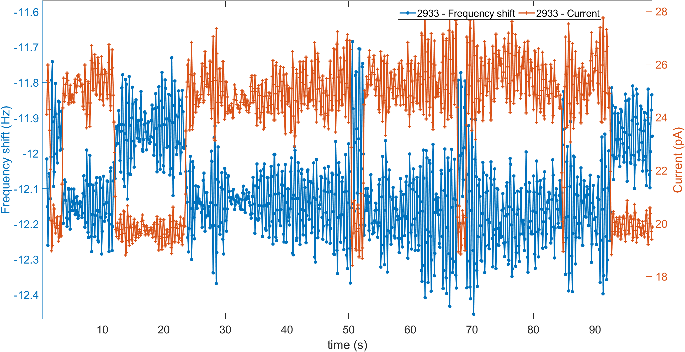
Fish: Switching
450 mV
1 nm
-11.93 ± 0.13 Hz
-12.15 ± 0.1 Hz
Distance from atom (nm) | Δdf
1 nm | 0.22
1.1 nm | 0.22
1.2 nm | 0.22
Δdf = 0.22 Hz
1.1 nm
-11.93 ± 0.15 Hz
-12.13 ± 0.15 Hz
Δdf = 0.20 Hz
1.2 nm: Δdf = 0.22 Hz

Slide 37
Conclusion
dIdV shows charging peak.
LCPD shows dip corresponding to a transiently charged atom.
Cannot distinguish two LCPD max.
Is the dip corresponding to a charging energy?
Current shows charging ring isotropic
df shows charging ring as isotropic but contrast within the ring is anisotropic
Hints to an anisotropic charge distribution in the substrate?

Slide 38
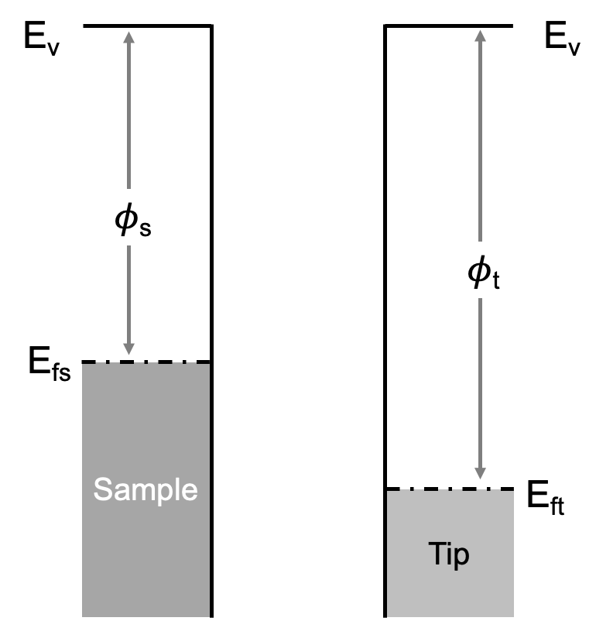
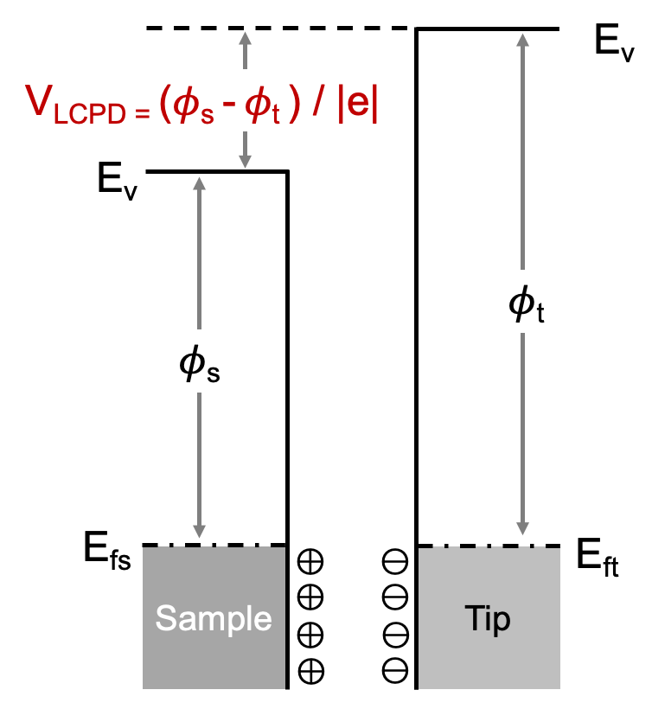
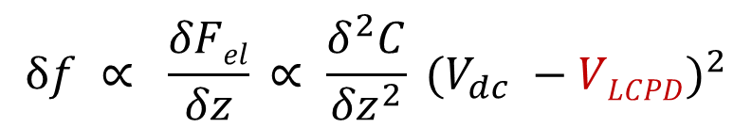
Local Contact Potential Difference (LCPD)
V_{dc}
$$δf ∝ \frac{δFel}{δz} ∝ \frac{δ^{2}C}{{δz}^{2}} {(V_{dc} −VLCPD)}^{2}$$
Wilhelm Melitz, et.al., Surface Science Reports, Volume 66, Issue 1 (2011) Noncontact Atomic Force Microscopy (Book)

Slide 39
Charging event in STS
Spatial extent of charging
Charging peak
3d Co state
V = 400mV
Inside: charged
Outside: neutral
B. Kiraly, et al., Nat. Comm. 9, 3904 (2018)

Slide 40
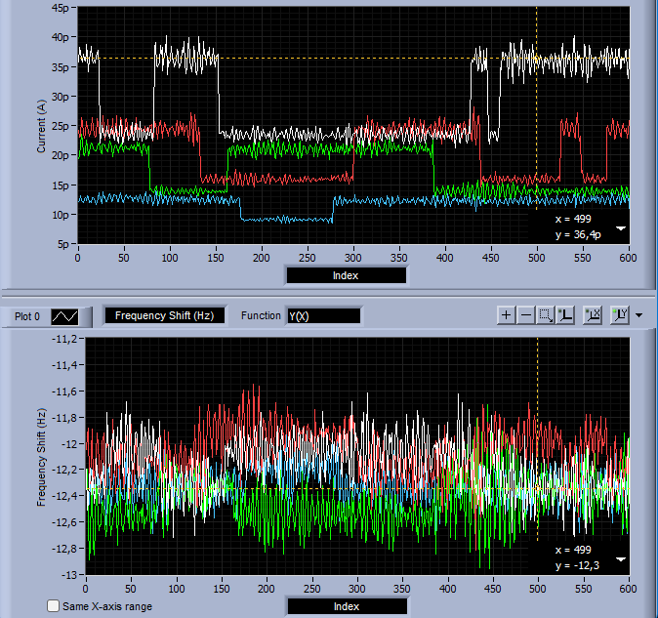
Switching moving away from Co
460 mV
Move in arrow direction, 1 nm, 1.1 nm, 1.2 nm, 1.3 nm
-400mV, 150pA

Slide 41


Switching vs amplitude
30 pm oscillation
-400mV, 250pA
70 pm oscillation
-400mV, 150pA

